Slide 1
Tubercle Testing
Jeremy Dawson

Slide 2
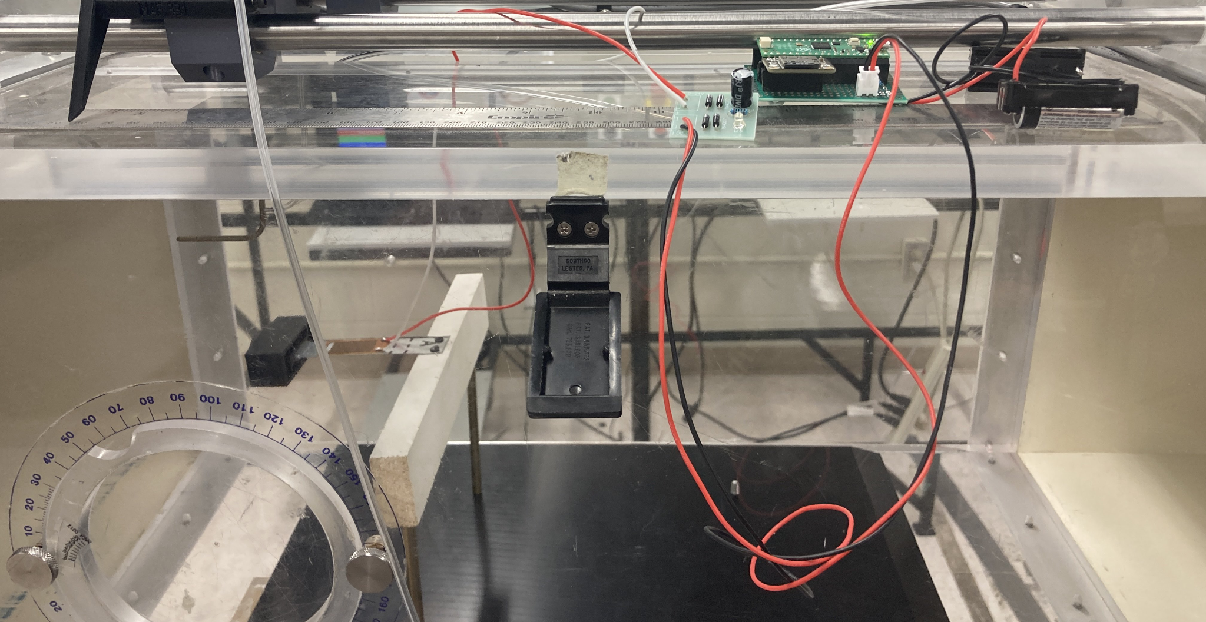
Testing Setup
Circuitry of an ADC Reader and a Full Bridge Rectifier.

Slide 3
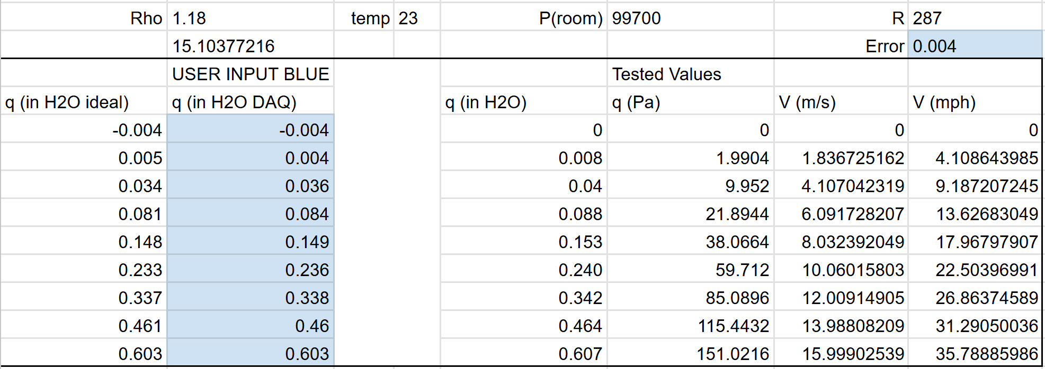
Testing Conditions
Environmental and Data Points Tested

Slide 4
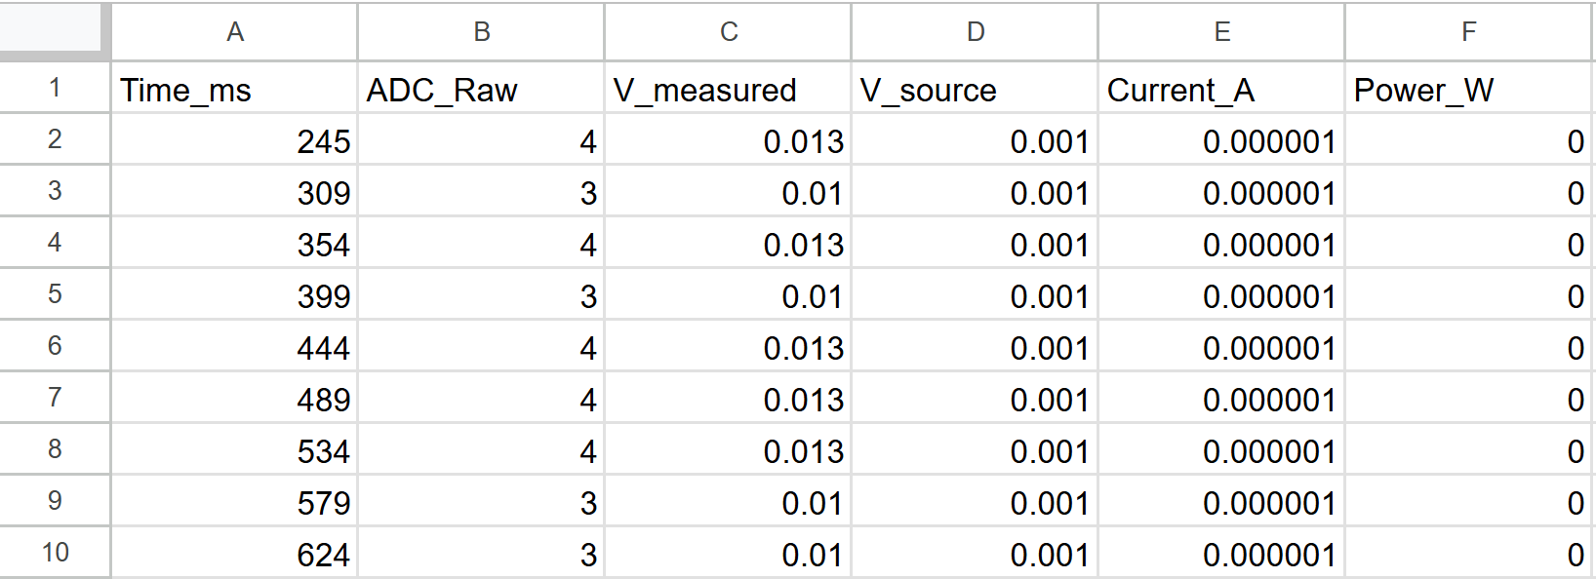
Data Collection
Important columns were Time_ms and V_measured. Data taken each ~50ms

Slide 5
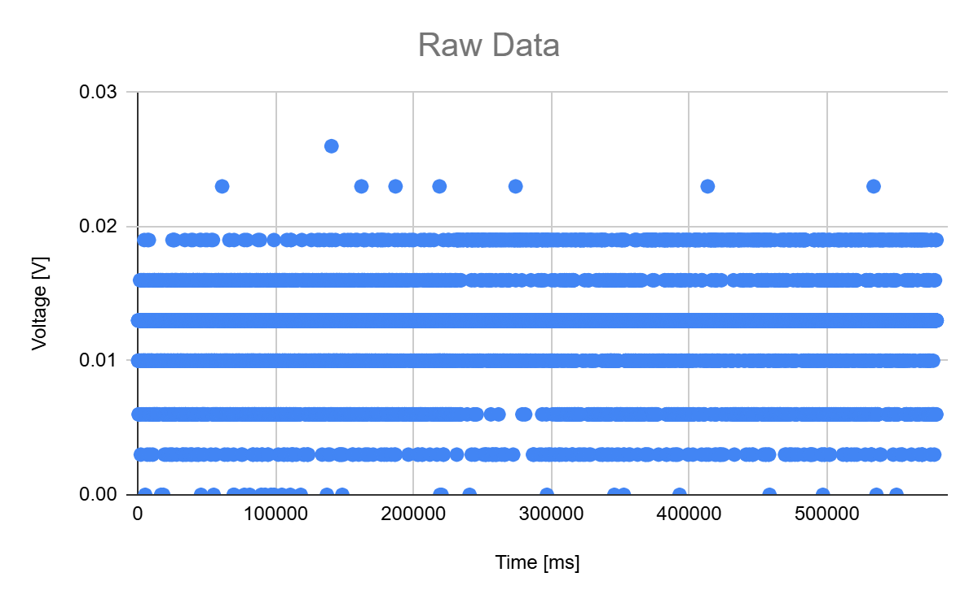
Raw Data Graph
Seems that voltage varied at consistent intervals - not holding steady

Slide 6
Comments
The data for the tubercle testing appeared to be non-conclusive.
Varied data at consistent intervals throughout each velocity on the wind tunnel
Only one piezoelectric sensor was utilized, so it could be that the data was not being collected properly.
Likely a setup error, but it could have been an issue with the tubercle setup.
Since the tubercle was 3D Printed and less heavy that the wood tubercle, it didn’t simply increase in frequency as the wind tunnel speed increase.
It is possible that lightweight tubercle was unable to provide a proper restorative force to the lever arm of the tubercle.

Slide 7
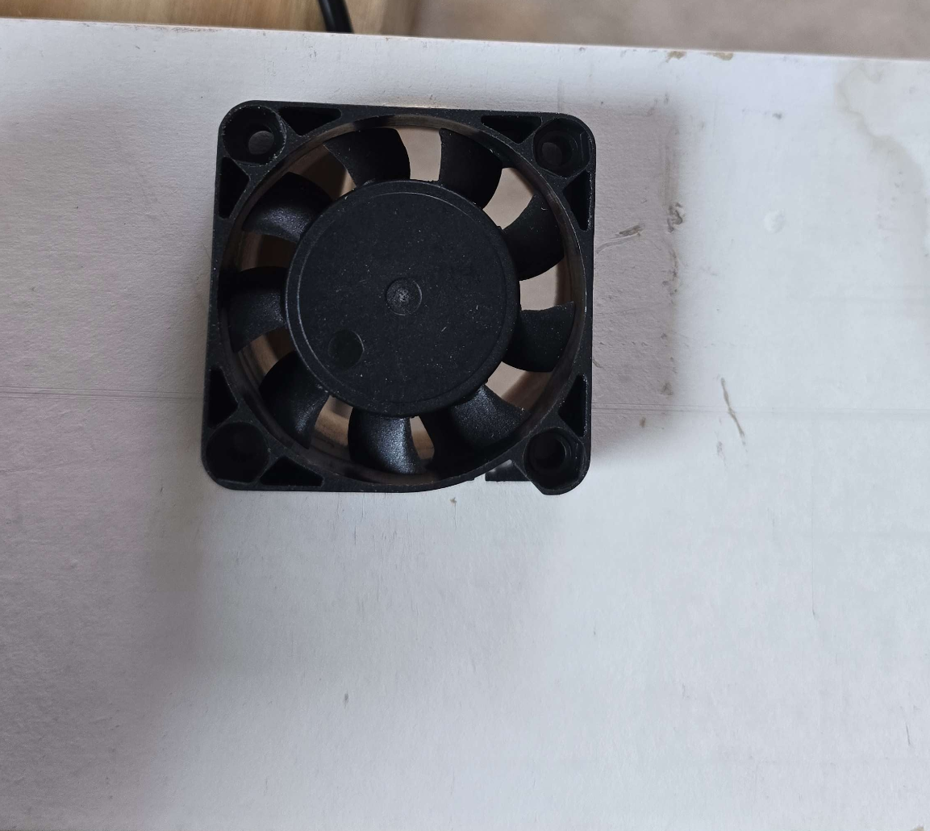
Fan Alternative Setup
Circuitry of an ADC Reader and a Full Bridge Rectifier.

Slide 8
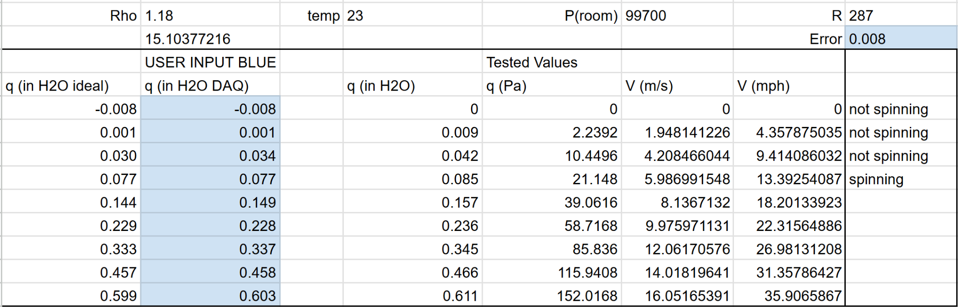
Testing Conditions
Environmental and Data Points Tested

Slide 9
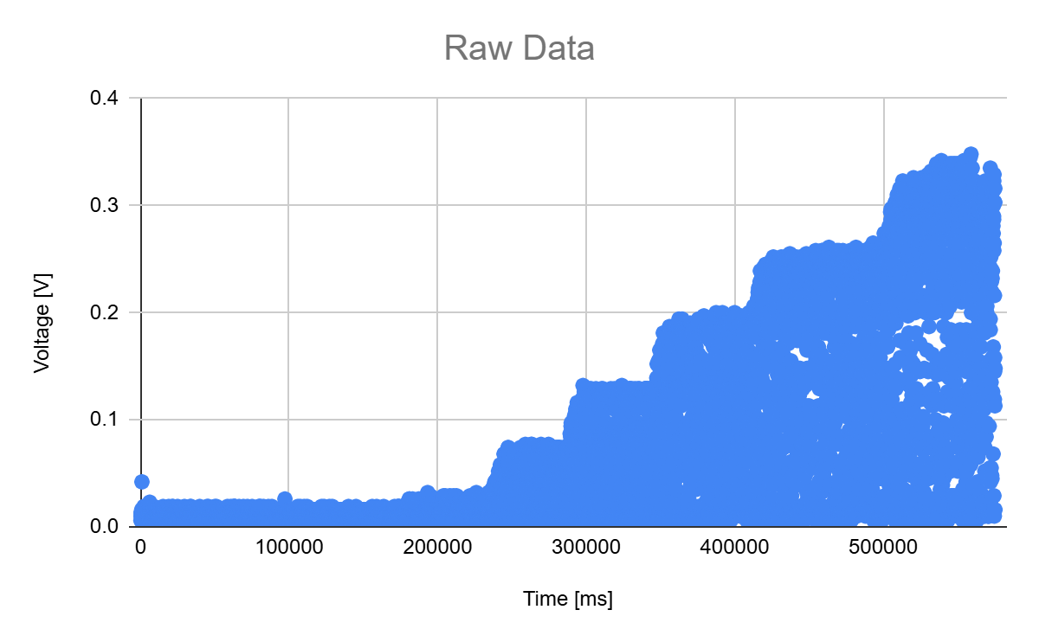
Raw Data Graph
Seems that voltage held consistent peaks with strange middle values

Slide 10
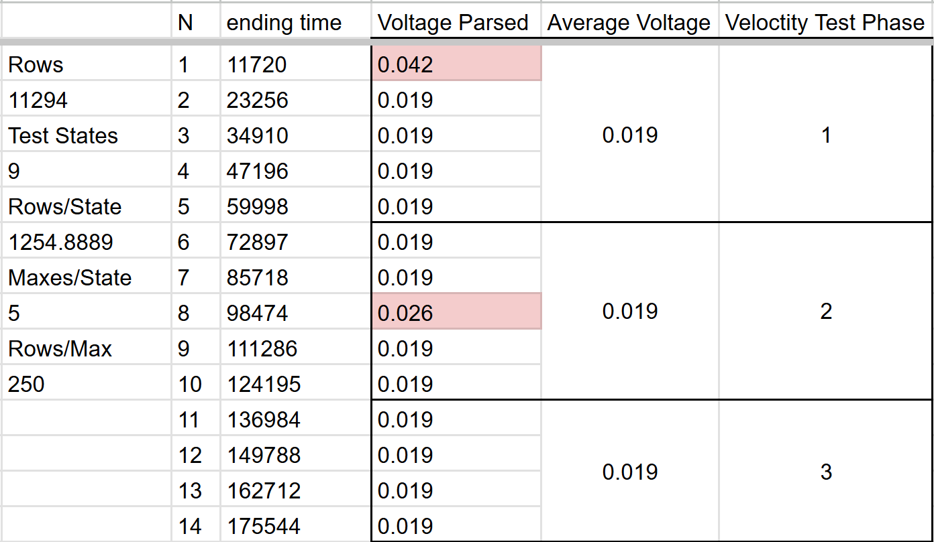
Data Parsing
Took the average max Voltage at each approximate testing condition

Slide 11
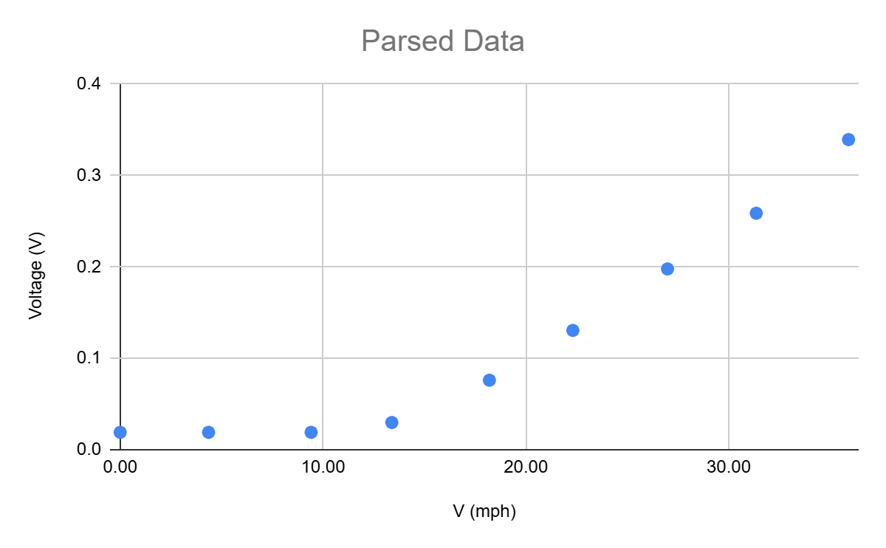
Parsed Data Graph
Sensor appears to not register below 0.019 V. Graph is a piecewise function

Slide 12
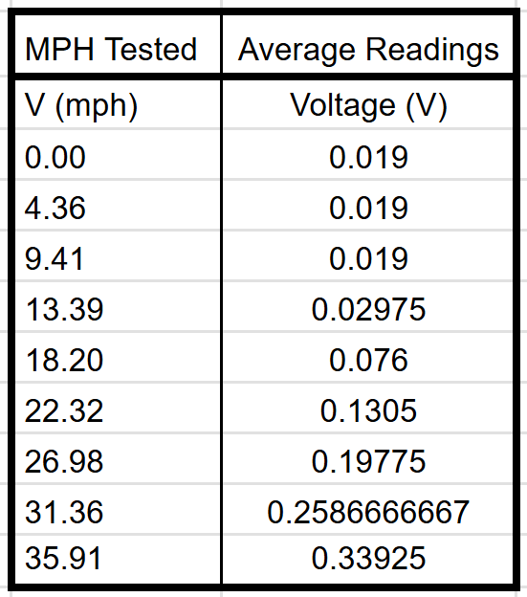
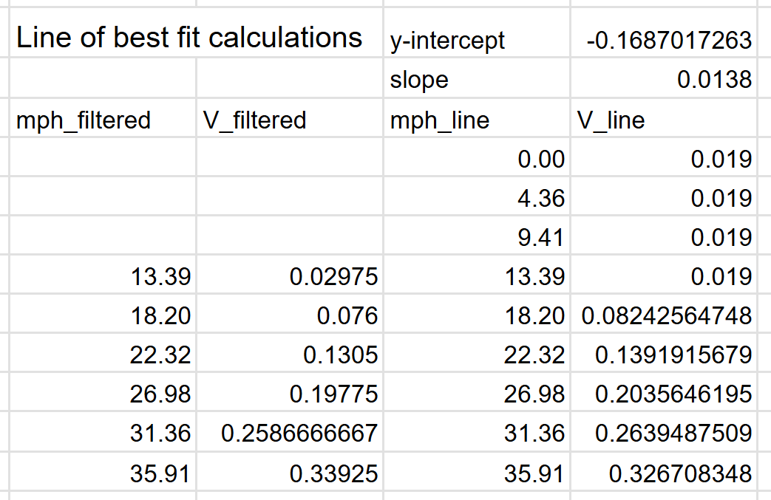
Line of Best Fit Calculations
Taken to predict fan readouts at any wind speed.

Slide 13
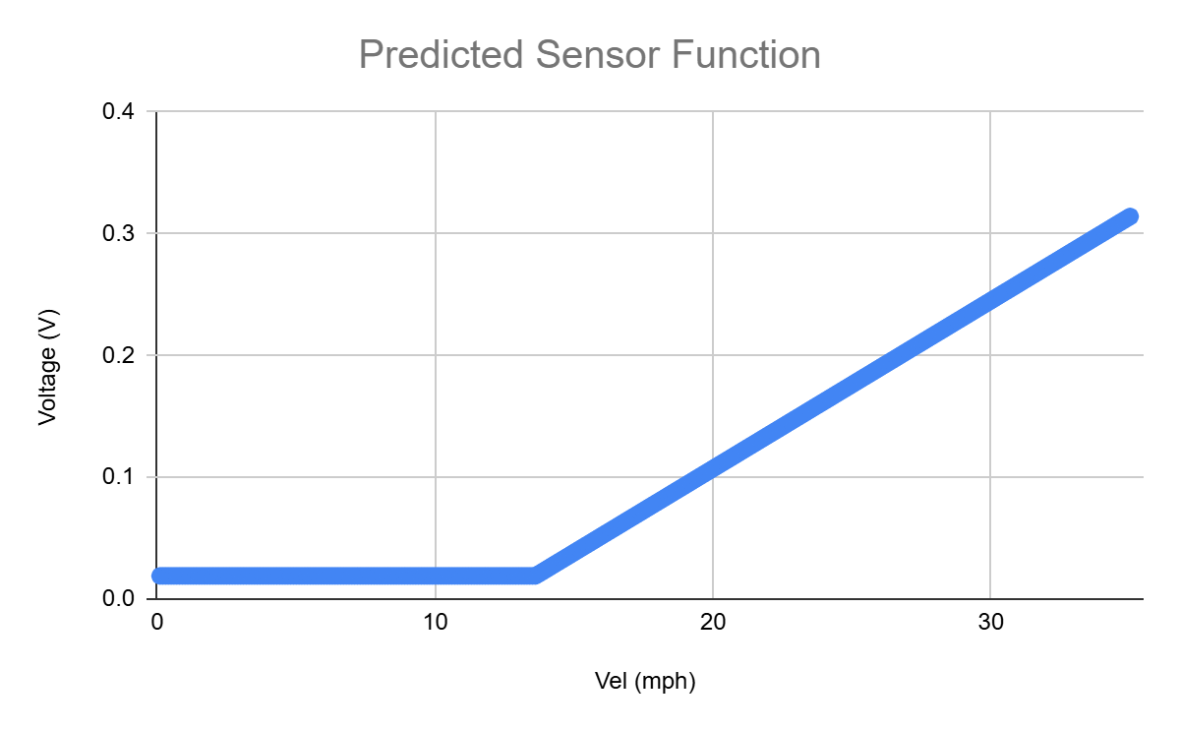
Fan Sensor Predictive Graph
Sensor appears to not register below 0.019 V. Graph is a piecewise function

Slide 14
Comments
The data for the fan testing appeared to be much more coherent.
Data is able to be parsed through simple manipulation and can be understood prior
The same exact circuitry was utilized between the tubercle and fan.
The intermediate values for the fan tests were likely due to the fan conversion to power generation method.
Contacts were scratched together inside of the laptop fan to make it produce power instead of intake power
It is extremely possible that the non-professional conversion lead to inconsistent data reading

